Slide 1
Balanced Search Trees
3.4 – 3.7
Team names
Majed Suhaim
Ahmed Sulaiman M Alharbi

Slide 2
Red-Black Trees
Definition: a binary search tree with nodes colored red and black such that:
the paths from the root to any leaf have the same number of black nodes,
there are no two consecutive red nodes, If a node is red, then both of its children are black
the root is black.

Slide 3
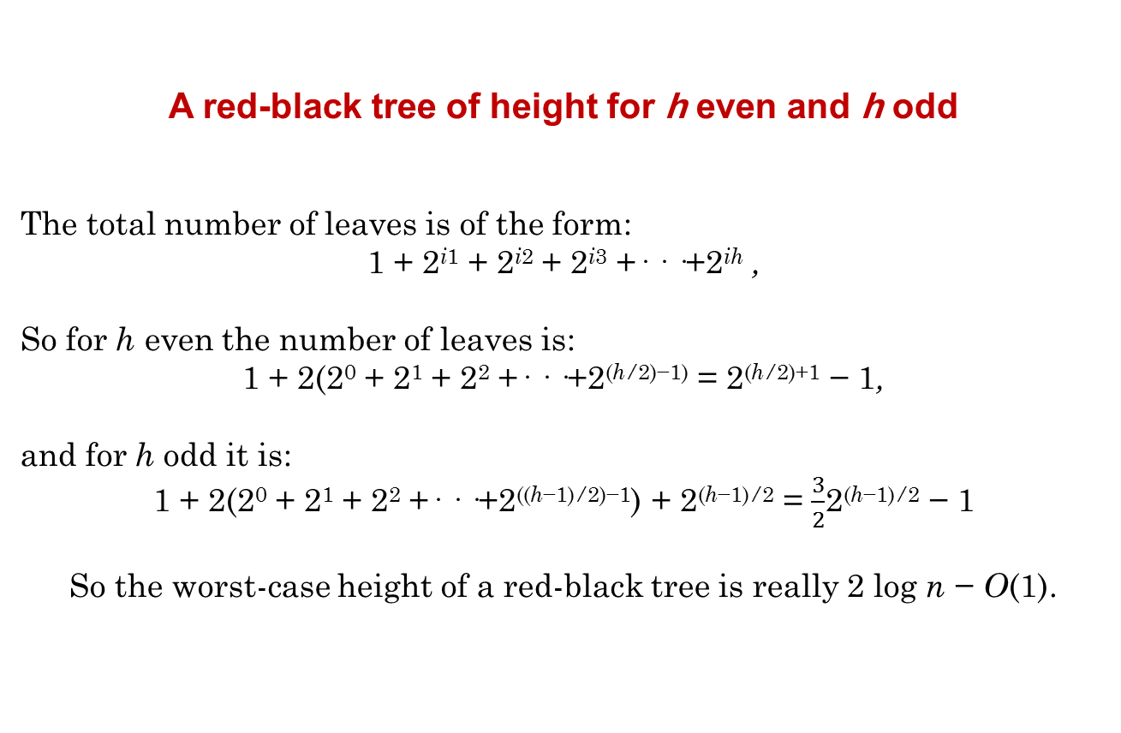
A red-black tree of height for h even and h odd
The total number of leaves is of the form:
1 + 2^{i1} + 2^{i2} + 2^{i3} +· · ·+2^{ih} ,
So for h even the number of leaves is:
1 + 2(2⁰ + 2¹ + 2² +· · ·+2^{(h/2)−1)} = 2^{(h/2)+1} − 1,
and for h odd it is:
1 + 2(2⁰ + 2¹ + 2² +· · ·+2^{((h−1)/2)−1}) + 2^{(h−1)/2} = $\frac{3}{2}$2^{(h−1)/2} − 1
So the worst-case height of a red-black tree is really 2 log n − O(1).

Slide 4
The height of red-black tree
Definition: The black-height of a node, x, in a red-black tree is the number of black nodes on any path to a leaf, not counting x.
Black-Height of the root = 2

Slide 5
Black-Height of the root = 3

Slide 6
Height-balanced trees
We have to maintain the following balancedness property
- Each path from the root to a leaf contains the same number of black nodes
bh =2
7
bh =1
3
18
bh =2
bh =1
10
22
bh =1
bh =1
8
11
26
bh =1

Slide 7
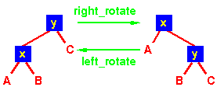
Rotation
A rotation is a local operation in a search tree that preserves in-order traversal key ordering.

Slide 8
Bottom-Up Rebalancing for Red-Black Trees
* The idea for insertion in a red-black tree is to insert like in a binary search tree and then reestablish the color properties through a sequence of recoloring and rotations
The rules are as follows:
1. If other is red, color current and other black and upper red.
2. If current = upper->left
2.1 If current->right->color is black,
perform a right rotation around upper and color upper->right
red.
2.2 If current->right->color is red,
perform a left rotation around current followed by a right rotation
around upper, and color upper->right and upper->left
black and upper red.
3. If current = upper->right
3.1 If current->left->color is black,
perform a left rotation around upper and color upper->left red.
3.2 If current->left->color is red,
perform a right rotation around current followed by a left rotation
around upper, and color upper->right and upper->left
black and upper red.

Slide 9
* We have 3 cases for insertion
Case 1: Recolor (uncle is red)
G
G
P
U
P
U

Slide 10
Case 2:
Double Rotate: X around P then X around G.
Recolor G and X
G
X
P
P
U
G
X
S
U
S

Slide 11
Case 3:
Single Rotate P around G
Recolor P and G
G
P
P
U
X
G
S
X
S
U

Slide 12
Analysis of Insertion
A red-black tree has O(log n) height
Search for insertion location takes O(log n) time because we visit O(log n) nodes
Addition to the node takes O(1) time
Rotation or recoloring takes O(log n) time because we perform
* O(log n) recoloring, each taking O(1) time, and
* at most one rotation taking O(1) time
- Thus, an insertion in a red-black tree takes O(log n) time

Slide 13
Deleting a node from a red-black tree is a bit more complicated than inserting a node.
If the node is red? Not a problem – no RB properties violated
If the node is black? deleting it will change the black-height along some path

Slide 14
* We have some cases for deletion
P
delete
U
S
V
Case A:
- V’s sibling, S, is Red
Rotate S around P and recolor S & P

Slide 15
S
P
Rotate S around P
P
V
S
V
S
Recolor S & P
P
V

Slide 16
P
delete
S
U
V
Case B:
- V’s sibling, S, is black and has two black children.
Recolor S to be Red
Red or Black and don’t care

Slide 17
Recolor S to be Red
P
P
S
V
S
V

Slide 18
P
delete
S
U
V
Case C:
- S is black
S’s RIGHT child is RED (Left child either color)
Rotate S around P
Swap colors of S and P, and color S’s Right child Black

Slide 19
S
P
Rotate S around P
P
S
V
V
S
P
Recolor: Swap colors of S and P, and color S’s Right child Black
V

Slide 20
P
delete
U
S
V
Case D:
- S is Black, S’s right child is Black and S’s left child is Red
i) Rotate S’s left child around S
ii) Swap color of S and S’s left child

Slide 21
P
P
S
V
V
P
S
Rotate S’s left child around S
V
S
Recolor: Swap color of S and S’s left child

Slide 22
Analysis of deletion
A red-black tree has O(log n) height
Search for deletion location takes O(log n) time
The swaping and deletion is O(1).
Each rotation or recoloring is O(1).
Thus, the deletion in a red-black tree takes O(log n) time

Slide 23
Red Black Trees
Top-Down Insertion

Slide 24
Review of Bottom-Up Insertion
In B-Up insertion, “ordinary” BST insertion was used, followed by correction of the tree on the way back up to the root
This is most easily done recursively
Insert winds up the recursion on the way down the tree to the insertion point
Fixing the tree occurs as the recursion unwinds

Slide 25
Top-Down Insertion Strategy
In T-Down insertion, the corrections are done while traversing down the tree to the insertion point.
When the actual insertion is done, no further corrections are needed, so no need to traverse back up the tree.
So, T-Down insertion can be done iteratively which is generally faster
Notes:
- So, walking down the tree to perform the insert and then walking back up to perform the rotates is double the work.
-here (top-down approach), shows how this double work can be avoided for the Red-Black tree as follows.

Slide 26
Goal of T-D Insertion
Insertion is always done as a leaf (as in ordinary BST insertion)
Recall from the B-Up flow chart that if the uncle of a newly inserted node is black, we restore the RB tree properties by one or two local rotations and recoloring – we do not need to make changes further up the tree

Slide 27
Goal (2)
Therefore, the goal of T-D insertion is to traverse from the root to the insertion point in such a way that RB properties are maintained, and at the insertion point, the uncle is Black.
That way we may have to rotate and recolor, but not propagate back up the tree

Slide 28
Possible insertion configurations
X (Red or Black)
Y
Z
If a new node is inserted as a child of Y or Z, there is no problem since the new node’s parent is black

Slide 29
Possible insertion configurations
X
Y
Z
If new node is child of Z, no problem since Z is black.
If new node is child of Y, no problem since the new node’s uncle (Z) is black – do a few rotations and recolor…. done

Slide 30
Possible insertion configurations
X
Y
Z
If new node is inserted as child of Y or Z, it’s uncle will be red and we will have to go back up the tree. This is the only case we need to avoid.

Slide 31
Top-Down Traversal
As we traverse down the tree and encounter this case, we recolor and possible do some rotations.
There are 3 cases.
X
Y
Z
Remember the goal – to create an insertion point at which the parent of the new node is Black, or the uncle of the new node is black.
Notes:
If on the way down we come across a node X with two red children, colour-flip it immediately!
But what if X's parent is also red? We break the invariant!

Slide 32
Case 1 – X’s Parent is Black
P
P
X
X
Y
Z
Y
Z
Just recolor and continue down the tree

Slide 33
Case 2
X’s Parent is Red (so Grandparent is Black) and X and P are both left/right children
Rotate P around G
Color P black
Color G red
Note that X’s uncle, U, must be black because it (a) was initially black, or (b) would have been made black when we encountered G (which would have had two red children -- X’s Parent and X’s uncle)

Slide 34
Case 2 diagrams
G
P
P
U
G
X
X
S
Z
Y
Z
Y
S
U
Rotate P around G. Recolor X, Y, Z, P and G

Slide 35
Case 3
X’s Parent is Red (so Grandparent is Black) and X and P are opposite children
Rotate P around G
Color P black
Color G red
Again note that X’s uncle, U, must be black because it (a) was initially black, or (b) would have been made black when we encountered G (which would have had two red children -- X’s Parent and X’s uncle)

Slide 36
Case 3 Diagrams (1 of 2)
G
G
X
P
U
U
P
Z
S
X
S
Y
Y
Z
Step 1 – recolor X, Y and Z. Rotate X around P.

Slide 37
Case 3 Diagrams (2 of 2)
X
G
X
U
P
G
P
Z
S
Y
Z
U
S
Y
Step 2 – Rotate X around G. Recolor X and G

Slide 38
Top-Down Insert Summary
Case 1
P is Black
Just Recolor
Recolor X,Y,Z
P
P
X
X
Y
Z
Y
Z
Case 2 P is Red X & P both left/right
G
G
Rotate P around G Recolor P,G
P
Recolor X,Y,Z
G
P
P
X
Y
Z
X
X
Y
Z
Y
Z
Case 3 P is Red X and P are opposite children
G
G
X
Recolor X,Y,Z Rotate X around P
Rotate X around G Recolor X, G
G
P
X
P
P
X
Y
Z
Y
Z
Y
Z

Slide 39
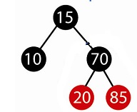
Notes:
Insert 60

Slide 40
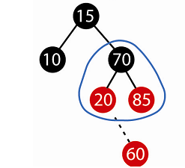
Notes:
Change the coloers

Slide 41
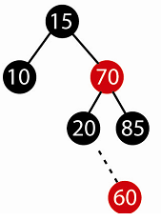
Notes:
The result

Slide 42
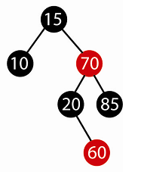
Notes:
Then we insert 60

Slide 43
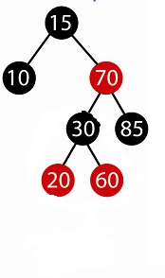
Another Example
Notes:
Insert 50

Slide 44
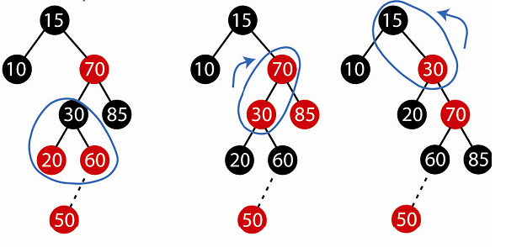
Notes:
Color Change

Slide 45
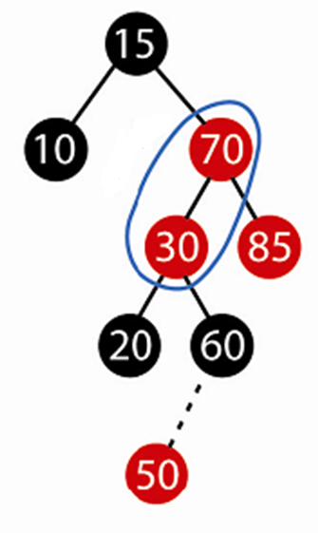
85

Slide 46
85
Notes:
Rotate

Slide 47
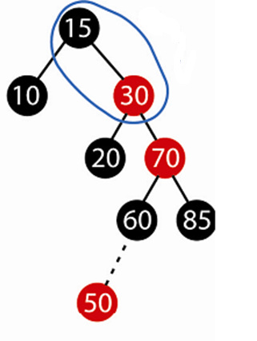

Slide 48
Notes:
Another Rotate

Slide 49
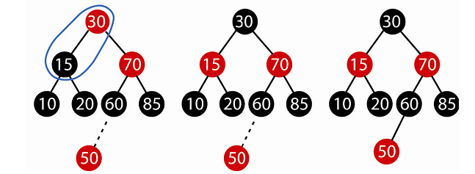
Notes:
Color Change

Slide 51
Notes:
This the result.

Slide 52
Red Black Trees
Top-Down Deletion

Slide 53
Recall the rules for BST deletion
If a node to be deleted is a leaf, just delete it.
If a node to be deleted has just one child, replace it with that child
If a node to be deleted has two children, replace the value of by it’s in-order predecessor’s value then delete the in-order predecessor (a recursive step)

Slide 54
What can go wrong?
If the delete node is red? Not a problem – no RB properties violated
If the deleted node is black? If the node is not the root, deleting it will change the black-height along some path

Slide 55
Terminology
Matching Weiss text section 12.2
X is the node being examined
T is X’s sibling
P is X’s (and T’s) parent
R is T’s right child
L is T’s left child.

Slide 56
Basic Strategy
As we traverse the tree, we change every node we visit, X, to Red.
When we change X to Red, we know
P is also Red (we just came from there)
T is black (since P is Red, it’s children are Black)

Slide 57
Step 1 – Examine the root
If both of the root’s children are Black
Make the root Red
Move X to the appropriate child of the root
Proceed to step 2
Otherwise designate the root as X and proceed to step 2B.

Slide 58
Step 2 – the main case
As we traverse down the tree, we continually encounter this situation until we reach the node to be deleted
X is Black, P is Red, T is Black
We are going to color X Red, then recolor other nodes and possibly do rotation(s) based on the color of X’s and T’s children
2A. X has 2 Black children
2B. X has at least one Red child

Slide 59
Case 2A X has two Black Children
2A1. T has 2 Black Children
2A2. T’s left child is Red
2A3. T’s right child is Red ** if both of T’s children are Red, we can do either 2A2 or 2A3
P
X
T

Slide 60
Case 2A1 X and T have 2 Black Children
P
P
X
T
X
T
Just recolor X, P and T and move down the tree

Slide 61
Case 2A2
X has 2 Black Children and T’s Left Child is Red
Rotate L around T, then L around P Recolor X and P then continue down the tree
L
P
T
X
P
T
L
L1
L2
X
L1
L2

Slide 62
Case 2A3
X has 2 Black Children and T’s Right Child is Red
Rotate T around P Recolor X, P, T and R then continue down the tree
T
P
X
R
T
P
R
R1
R2
X
L
L
R1
R2

Slide 63
Case 2B X has at least one Red child
Continue down the tree to the next level
If the new X is Red, continue down again
If the new X is Black (T is Red, P is Black)
Rotate T around P
Recolor P and T
Back to main case – step 2

Slide 64
Case 2B Diagram
P
X
T
Move down the tree.
P
P
X
T
T
X
If move to Black child (2B2) Rotate T around P; Recolor P and T Back to step 2, the main case
If move to the Red child (2B1) Move down again

Slide 65
Step 3
Eventually, find the node to be deleted – a leaf or a node with one non-null child that is a leaf.
Delete the appropriate node as a Red leaf
Step 4
Color the Root Black

Slide 66
Example 1 Delete 10 from this RB Tree
15
6
17
12
20
3
16
10
13
18
23
7
Step 1 – Root has 2 Black children. Color Root Red
Descend the tree, moving X to 6

Slide 67
Example 1 (cont’d)
15
X
6
17
12
20
3
16
10
13
18
23
7
One of X’s children is Red (case 2B). Descend down the tree, arriving at 12. Since the new X (12) is also Red (2B1), continue down the tree, arriving at 10.

Slide 68
Example 1 (cont’d)
15
6
17
12
20
3
16
10
X
13
18
23
7
Step 3 -Since 10 is the node to be deleted, replace it’s value with the value of it’s only child (7) and delete 7’s red node

Slide 69
Example 1 (cont’d)
15
6
17
12
20
3
16
7
13
18
23
The final tree after 7 has replaced 10 and 7’s red node deleted and (step 4) the root has been colored Black.

Slide 70
Trees with Constant Update Time at a Known Location
The insertion and deletion operations, along with the tree rearrangement and recoloring, are performed in O(log n) time.
insertion will take O(1), if the location is already known.

Slide 71
Finger Trees and Level Linking
The idea of finger trees is that searching for an element should be faster if the position of a nearby element is known. This nearby element is known as the “finger.” The search time should not depend on the total size of the underlying set S, but only on the neighborhood or distance from the finger f to the element q that is searched.

Slide 72
The finger search method
A finger search method could have the following outline: go from the finger leaf several levels up, move in the list of nodes at level i in the right direction till the subtree with the query element is found, and then go down in the tree again to the query element

Slide 73
- The paths from the root to the leaves have different lengths
* We need to maintain two conditions:
1. within each level, the intervals associated with the nodes form a partition
of ]−∞,∞[
2. along each path from the root to a leaf, the number of nodes between two
nodes of consecutive levels is bounded by a constant C.

Slide 74
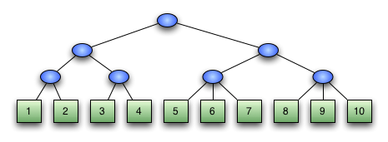
2-3 tree of integers
To make it a finger tree, what you do, in theory, is reach down to the leftmost and rightmost internal nodes of the tree – in our case, the parents of (1,2) and (8, 9, 10). Then you pick up the tree by those two nodes, and let the rest dangle down.

Slide 75
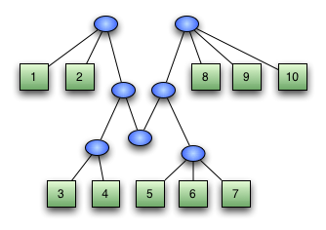
If you look at this, you’ve got a finger for the node (1,2), and a finger for the node (8,9,10). In between them, you’ve got a bunch of stuff dangling. But if you look at the dangling stuff: it’s a finger tree.

